Slide 1
Simulation activities in jammu
MUKESH SHARMA
RESEARCH SCHOLAR
UNIVERSITY OF JAMMU

Slide 2
What we have done
CBM VERSION:TRUNK VERSION
Geometry: Standard geometry
Simulation study for two energies
12Gev/n au-au 3k events
30Gev/n p-au 3k events
GENERATION:
Bkg(urqmd)
Signal(pluto)
& Run the complete chain.

Slide 3
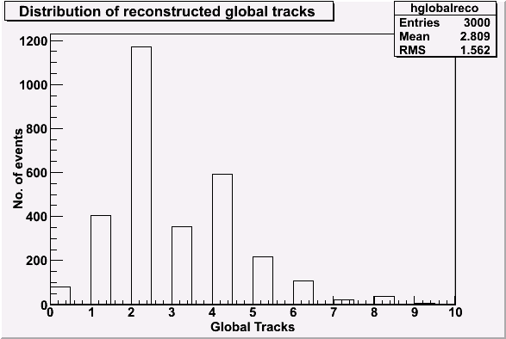
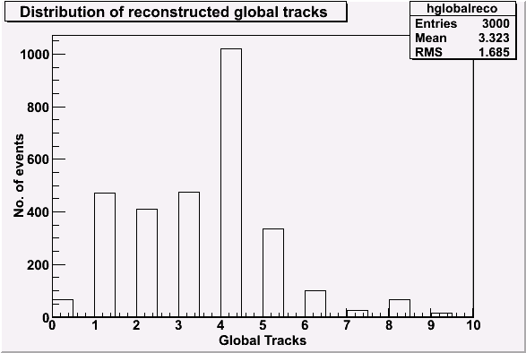
12GeV
30 GeV

Slide 4
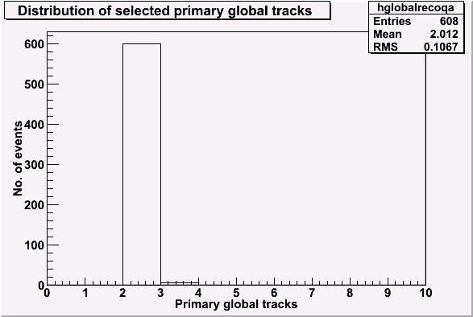
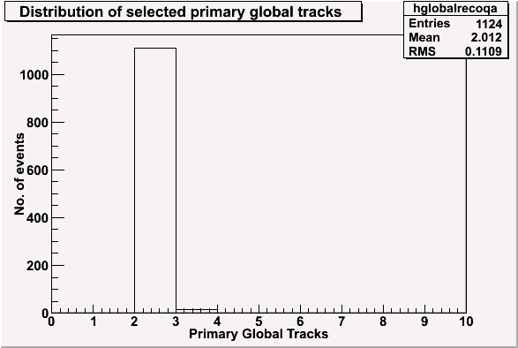
12 GeV
30 GeV

Slide 5
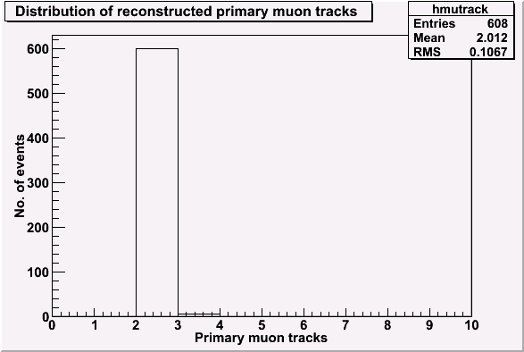
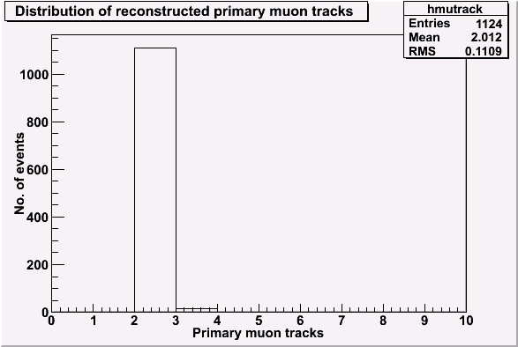
12 GeV
Primary muon track:
Pdgcode=13
if 13 then mu+& if-13then mu-
30 GeV

Slide 6
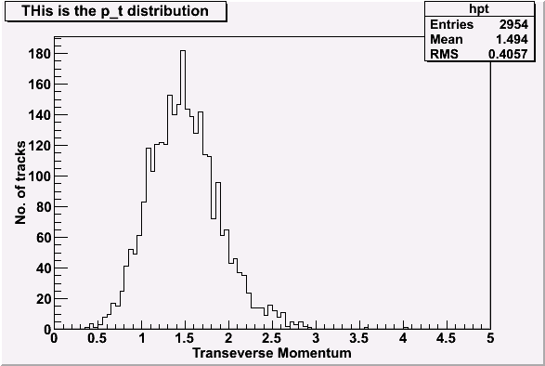
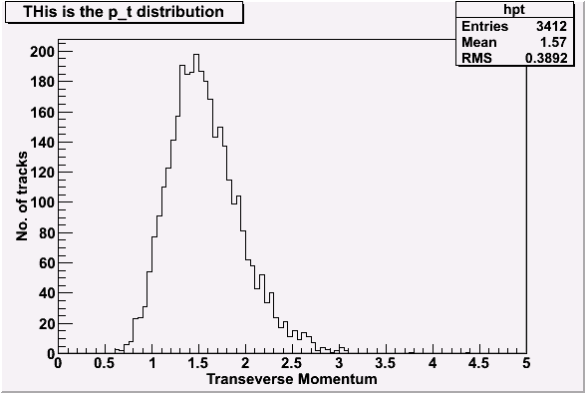
12 GeV
30 GeV

Slide 7
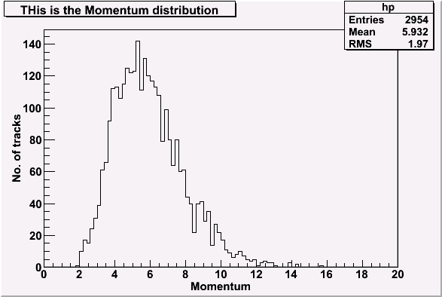
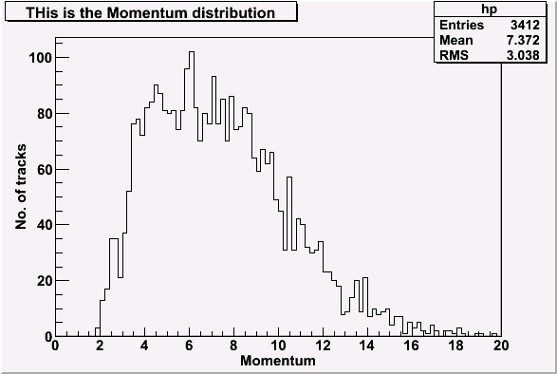
12 GeV
30 GeV

Slide 8
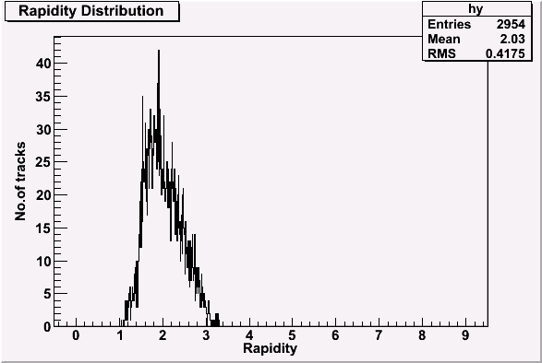
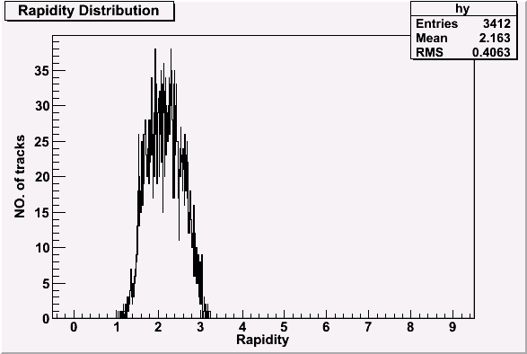
12 GeV
30 GeV

Slide 9
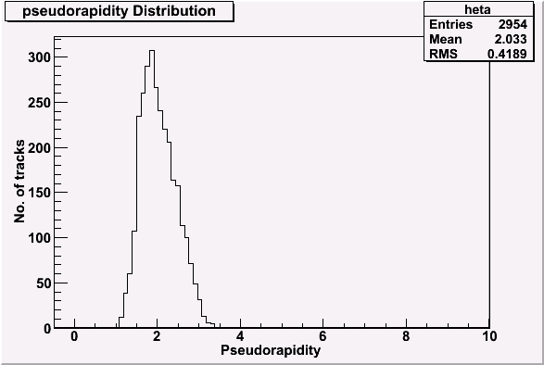
12 GeV
30 GeV

Slide 10
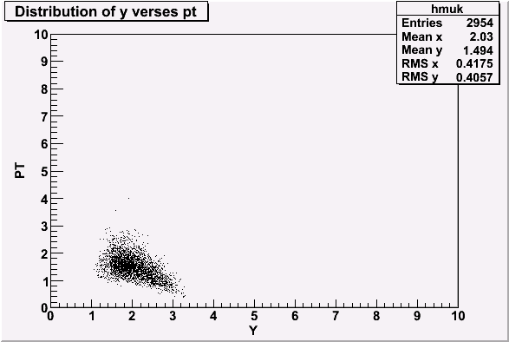
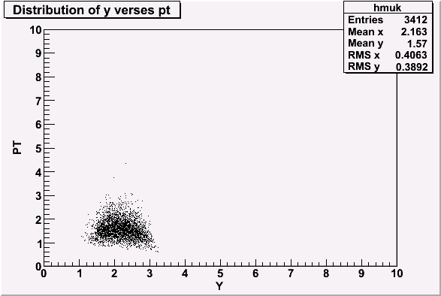
12 GeV
30GeV

Slide 11
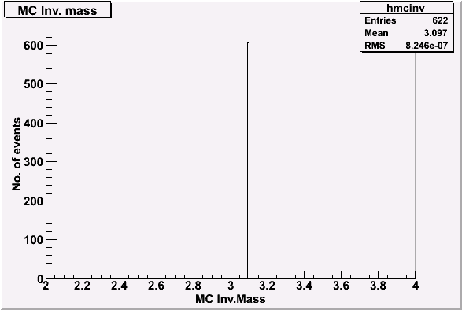
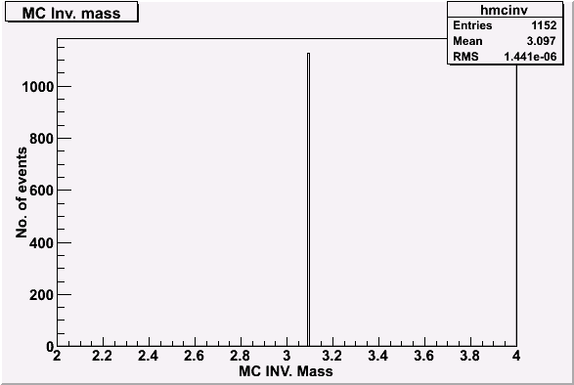
12 GeV
30 GeV

Slide 12
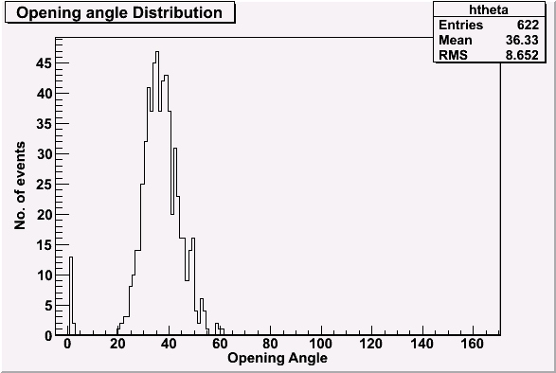
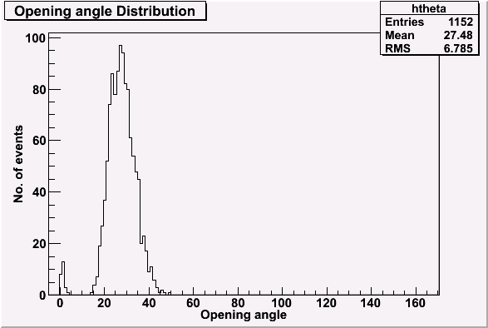
12GeV
30GeV

Slide 13
FUTURE PLANS
To read the bkg
To get the reconstructed invariant mass distribution using reco. Muon momentum at the target & also Y, p_t, acceptance,eta.opening angle.

